Slide 1
CENG2400 Embedded System Design Tutorial 05: UART Communication
Chenchen ZHAO
cczhao@cse.cuhk.edu.hk

Slide 2
Outline
Step 1: Connect the Bluetooth HC-05 module to Tiva
Step 2: Enter Bluetooth AT mode and configure the Bluetooth module
Step 3: Exit Bluetooth AT mode and run the code

Slide 3

Objective
UART0
115200
UART0
115200
Tiva
Tiva
LED
Bluetooth
Bluetooth
UART5
38400
UART5
38400
SW1
SPP
38400
Wireless control

Slide 4
Objective
Two bi-directional UART communications involved:
PC – Tiva: UART0 with baud rate 115200
Tiva – Bluetooth: UART5 with baud rate 38400

Slide 5
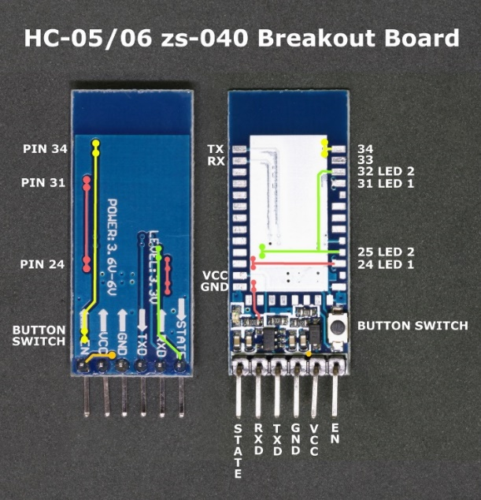
Step 1: Connect the Bluetooth HC-05 module to Tiva
HC-05: a basic Bluetooth module
VCC & GND for power
Read (RXD) & Write (TXD) for serial communication
EN for AT mode
STATE for state indication
https://components101.com/sites/default/files/component_datasheet/HC-05%20Datasheet.pdf
Details will be introduced in future lectures…

Slide 6
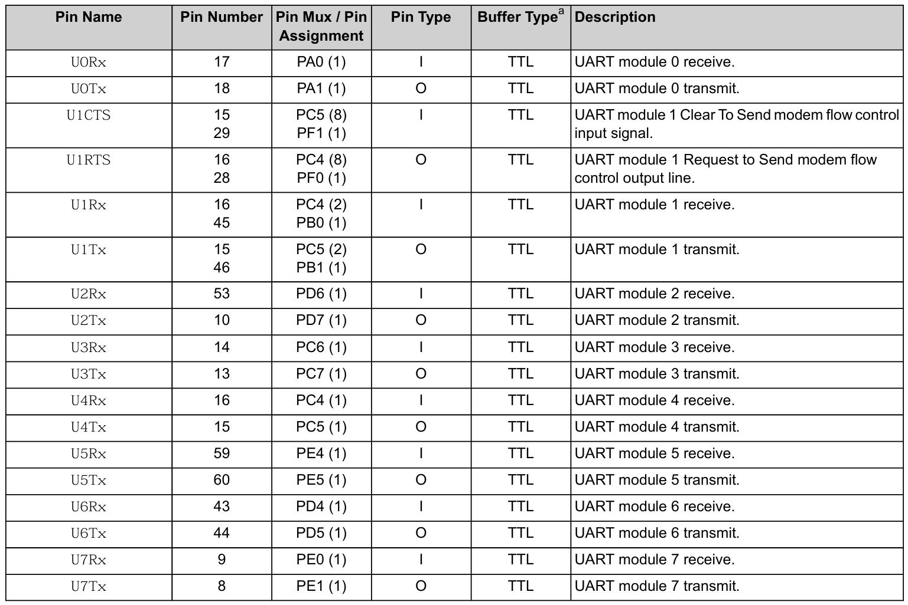
Step 1: Connect the Bluetooth HC-05 module to Tiva
(Tiva) TM4C123GH6PM microcontroller: 8 UART modules
You may try other UART modules for Tiva-PC and Tiva-Bluetooth communications (e.g., UART3)
https://www.ti.com/lit/ds/symlink/tm4c123gh6pm.pdf

Slide 7
Step 1: Connect the Bluetooth HC-05 module to Tiva
Connection: Bluetooth -> Tiva
RXD -> PE5
TXD -> PE4
GND -> GND
VCC -> VBUS
EN -> VCC only in AT mode!

Slide 8
Step 2: Enter Bluetooth AT mode and configure the Bluetooth module
Step 2.1: Enable Bluetooth AT mode
Step 2.2: Check current Bluetooth configurations
Step 2.3: Modify Bluetooth configurations for the master and the slave
Step 2.4: Read and understand the code

Slide 9
Step 2.1: Enable Bluetooth AT mode
Connect Bluetooth-EN to Tiva-VCC
Push down the button on the Bluetooth module and power off the board
Hold down the button and power up the board until the LED blinks slowly (with a period of ~2s)

Slide 10
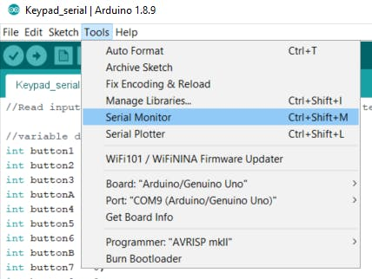
Step 2.2: Check current Bluetooth configurations
Create a project using main_at.c (as main.c)
Use a serial monitor (e.g., RealTerm, Arduino serial monitor) to monitor Tiva via UART
You need to set the correct channel (COMx), display mode (Both NL & CR) and baud rate 115200 on the serial monitor panel
See “UART0 Connected!”

Slide 11
Step 2.2: Check current Bluetooth configurations
Input AT and see OK if Bluetooth is successfully connected to Tiva
Try commands:
AT+UART? to check the baud rate
AT+ROLE? to check the role (master / slave)
AT+ADDR? to check the MAC address
Check this out: How To Configure and Pair Two HC-05 Bluetooth Modules as Master and Slave | AT Commands - How To Mechatronics

Slide 12
Step 2.3: Modify Bluetooth configurations for the master and the slave
Slave:
AT+UART=38400,0,0 to set the baud rate
AT+ROLE=0 to set the role slave
AT+ADDR? to check the address
Master:
AT+UART=38400,0,0 to set the baud rate
AT+ROLE=1 to set the role master
AT+CMODE=0 to set fixed-address mode
AT+BIND=xxx to bind the slave address

Slide 13
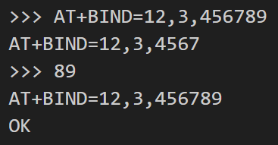
Step 2.3: Modify Bluetooth configurations for the master and the slave
Notes:
Replace ‘:’ in the address by ‘,’ when binding
Sometimes, the address is too long, and the Bluetooth module truncates it. Input the truncated part to continue
An AT command is successful only if the program returns OK. If the program does not return anything, press Enter again

Slide 14
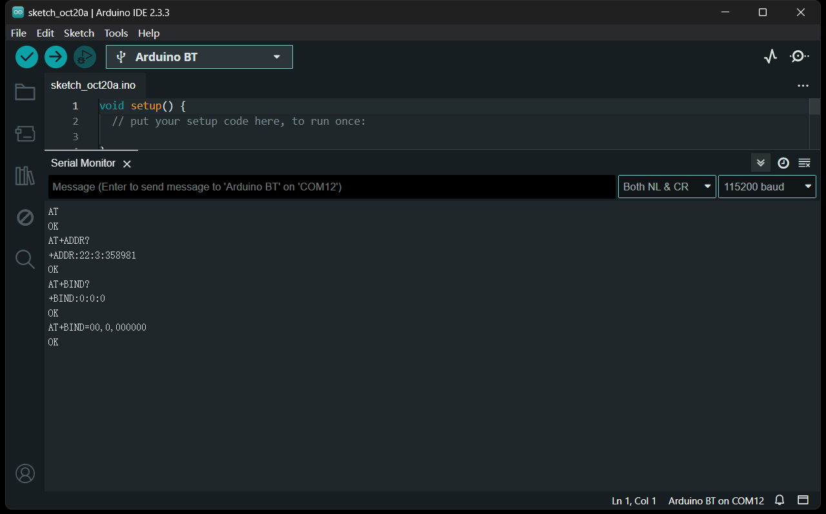
Step 2.3: Modify Bluetooth configurations for the master and the slave
Don’t care

Slide 15
Step 2.4: Read and understand the code
Understanding main_at.c:
SysCtlPeripheralEnable(SYSCTL_PERIPH_UARTx): enable the UARTx module
GPIOPinConfigure(GPIO_PIN_UxRX): binding PIN to UARTx-read
GPIOPinConfigure(GPIO_PIN_UxTX): binding PIN to UARTx-write
GPIOPinTypeUART(GPIO_PORTX_BASE, PIN): set PIN of base X as type UART
UARTConfigSetExpClk(UARTx_BASE, SysCtlClockGet(), BAUDRATE, (UART_CONFIG_WLEN_8 | UART_CONFIG_STOP_ONE | UART_CONFIG_PAR_NONE)): set the baud rate of UARTx BAUDRATE, and complete other UART settings
UARTCharPut(UARTx_BASE, c): send char c to UARTx
UARTCharsAvail(UARTx_BASE): whether UARTx has chars to receive
UARTCharGet(UARTx_BASE): receive a char from UARTx
UARTIntStatus(UARTx_BASE, true): check UARTx interrupt status
UARTIntClear(UARTx_BASE, STATUS): clear UARTx interrupt status

Slide 16
Step 2.4: Read and understand the code
UART0
115200
UART0
115200
Tiva
Tiva
LED
Bluetooth
Bluetooth
UART5
38400
UART5
38400
SW1
SPP
38400
Wireless control

Slide 17
Step 2.4: Read and understand the code
UART0
115200
Tiva
Bluetooth
UART5
38400

Slide 18
Step 2.4: Read and understand the code
AT
UART0
115200
Tiva
Bluetooth
UART5
38400

Slide 19
Step 2.4: Read and understand the code
A
T
UART0
115200
Tiva
Bluetooth
UART5
38400

Slide 20
Step 2.4: Read and understand the code
UART0
115200
A
T
Tiva
Bluetooth
UART5
38400

Slide 21
Step 2.4: Read and understand the code
UART0IntHandler
UART0
115200
A
T
Tiva
Bluetooth
UART5
38400

Slide 22
Step 2.4: Read and understand the code
UARTCharsAvail(UART0_BASE) == true
UART0IntHandler
UART0
115200
A
T
Tiva
Bluetooth
UART5
38400

Slide 23
Step 2.4: Read and understand the code
UARTCharsAvail(UART0_BASE) == true
UART0IntHandler
UART0
115200
A
T
Tiva
char a = UARTCharGet(UART0_BASE)
UARTCharPut(UART0_BASE, a)
UARTCharPut(UART5_BASE, a)
Bluetooth
UART5
38400

Slide 24
Step 2.4: Read and understand the code
UARTCharsAvail(UART0_BASE) == true
UART0IntHandler
UART0
115200
T
Tiva
char a = UARTCharGet(UART0_BASE)
UARTCharPut(UART0_BASE, a)
UARTCharPut(UART5_BASE, a)
A
Bluetooth
UART5
38400

Slide 25
Step 2.4: Read and understand the code
UARTCharsAvail(UART0_BASE) == true
UART0IntHandler
UART0
115200
T
Tiva
char a = UARTCharGet(UART0_BASE)
UARTCharPut(UART0_BASE, a)
UARTCharPut(UART5_BASE, a)
A
A
Bluetooth
UART5
38400

Slide 26
Step 2.4: Read and understand the code
UARTCharsAvail(UART0_BASE) == true
UART0IntHandler
UART0
115200
T
A
Tiva
char a = UARTCharGet(UART0_BASE)
UARTCharPut(UART0_BASE, a)
UARTCharPut(UART5_BASE, a)
Bluetooth
A
UART5
38400

Slide 27
Step 2.4: Read and understand the code
A
UARTCharsAvail(UART0_BASE) == true
UART0IntHandler
UART0
115200
T
Tiva
char a = UARTCharGet(UART0_BASE)
UARTCharPut(UART0_BASE, a)
UARTCharPut(UART5_BASE, a)
Bluetooth
UART5
38400
A

Slide 28
Step 2.4: Read and understand the code
A
UARTCharsAvail(UART0_BASE) == true
UART0IntHandler
UART0
115200
Tiva
char a = UARTCharGet(UART0_BASE)
UARTCharPut(UART0_BASE, a)
UARTCharPut(UART5_BASE, a)
T
Bluetooth
UART5
38400
A

Slide 29
Step 2.4: Read and understand the code
A
UARTCharsAvail(UART0_BASE) == true
UART0IntHandler
UART0
115200
Tiva
char a = UARTCharGet(UART0_BASE)
UARTCharPut(UART0_BASE, a)
UARTCharPut(UART5_BASE, a)
T
T
Bluetooth
UART5
38400
A

Slide 30
Step 2.4: Read and understand the code
A
UARTCharsAvail(UART0_BASE) == true
UART0IntHandler
UART0
115200
Tiva
T
char a = UARTCharGet(UART0_BASE)
UARTCharPut(UART0_BASE, a)
UARTCharPut(UART5_BASE, a)
Bluetooth
T
UART5
38400
A

Slide 31
Step 2.4: Read and understand the code
A
T
UARTCharsAvail(UART0_BASE) == true
UART0IntHandler
UART0
115200
Tiva
char a = UARTCharGet(UART0_BASE)
UARTCharPut(UART0_BASE, a)
UARTCharPut(UART5_BASE, a)
Bluetooth
UART5
38400
A
T

Slide 32
Step 2.4: Read and understand the code
A
T
UARTCharsAvail(UART0_BASE) == false
UART0IntHandler
UART0
115200
Tiva
char a = UARTCharGet(UART0_BASE)
UARTCharPut(UART0_BASE, a)
UARTCharPut(UART5_BASE, a)
Bluetooth
UART5
38400
A
T

Slide 33
Step 2.4: Read and understand the code
A
T
UARTCharsAvail(UART0_BASE) == false
UART0IntHandler
UART0
115200
Tiva
Bluetooth
UART5
38400
A
T

Slide 34
Step 2.4: Read and understand the code
A
T
UART0
115200
Tiva
Bluetooth
Bluetooth:
Someone asks me “AT”. I should reply “OK”.
UART5
38400
A
T

Slide 35
Step 2.4: Read and understand the code
A
T
UART0
115200
Tiva
Bluetooth
UART5
38400

Slide 36
Step 2.4: Read and understand the code
A
T
UART0
115200
Tiva
Bluetooth
UART5
38400
O
K

Slide 37
Step 2.4: Read and understand the code
A
T
UART0
115200
Tiva
Bluetooth
O
UART5
38400
K

Slide 38
Step 2.4: Read and understand the code
A
T
UART0
115200
Tiva
Bluetooth
O
UART5
38400
K
UART5IntHandler

Slide 39
Step 2.4: Read and understand the code
A
T
UART0
115200
Tiva
Bluetooth
O
UART5
38400
K
UART5IntHandler
UARTCharsAvail(UART5_BASE) == true

Slide 40
Step 2.4: Read and understand the code
A
T
UART0
115200
Tiva
char b = UARTCharGet(UART5_BASE)
UARTCharPut(UART0_BASE, b)
Bluetooth
O
UART5
38400
K
UART5IntHandler
UARTCharsAvail(UART5_BASE) == true

Slide 41
Step 2.4: Read and understand the code
A
T
UART0
115200
Tiva
char b = UARTCharGet(UART5_BASE)
UARTCharPut(UART0_BASE, b)
O
Bluetooth
K
UART5
38400
UART5IntHandler
UARTCharsAvail(UART5_BASE) == true

Slide 42
Step 2.4: Read and understand the code
A
T
UART0
115200
Tiva
O
char b = UARTCharGet(UART5_BASE)
UARTCharPut(UART0_BASE, b)
Bluetooth
K
UART5
38400
UART5IntHandler
UARTCharsAvail(UART5_BASE) == true

Slide 43
Step 2.4: Read and understand the code
A
T
O
UART0
115200
Tiva
char b = UARTCharGet(UART5_BASE)
UARTCharPut(UART0_BASE, b)
Bluetooth
K
UART5
38400
UART5IntHandler
UARTCharsAvail(UART5_BASE) == true

Slide 44
Step 2.4: Read and understand the code
A
T
O
UART0
115200
Tiva
char b = UARTCharGet(UART5_BASE)
UARTCharPut(UART0_BASE, b)
K
Bluetooth
UART5
38400
UART5IntHandler
UARTCharsAvail(UART5_BASE) == true

Slide 45
Step 2.4: Read and understand the code
A
T
O
UART0
115200
Tiva
K
char b = UARTCharGet(UART5_BASE)
UARTCharPut(UART0_BASE, b)
Bluetooth
UART5
38400
UART5IntHandler
UARTCharsAvail(UART5_BASE) == true

Slide 46
Step 2.4: Read and understand the code
A
T
O
K
UART0
115200
Tiva
char b = UARTCharGet(UART5_BASE)
UARTCharPut(UART0_BASE, b)
Bluetooth
UART5
38400
UART5IntHandler
UARTCharsAvail(UART5_BASE) == true

Slide 47
Step 2.4: Read and understand the code
A
T
O
K
UART0
115200
Tiva
char b = UARTCharGet(UART5_BASE)
UARTCharPut(UART0_BASE, b)
Bluetooth
UART5
38400
UART5IntHandler
UARTCharsAvail(UART5_BASE) == false

Slide 48
Step 2.4: Read and understand the code
A
T
O
K
UART0
115200
Tiva
Bluetooth
UART5
38400
UART5IntHandler
UARTCharsAvail(UART5_BASE) == false

Slide 49
Step 2.4: Read and understand the code
A
T
O
K

Slide 50
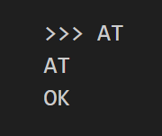
Step 2.4: Read and understand the code
A
T
O
K

Slide 51
Step 3: Exit Bluetooth AT mode and complete the program
Disconnect Bluetooth-EN from Tiva-VCC
Push down the button on the Bluetooth module and power off the board
Hold down the button and power up the board until the LED blinks very quickly

Slide 52
Step 3: Exit Bluetooth AT mode and complete the program
Create and complete project 1 using main_master.c (as main.c)
Compile and flash project 1 onto the master board
Create and complete project 2 using main_slave.c (as main.c)
Compile and flash project 2 onto the slave board
Refer to main_at.c for UART implementations

Slide 53
Step 3: Exit Bluetooth AT mode and complete the program
UART0
115200
UART0
115200
Tiva
Tiva
LED
Bluetooth
Bluetooth
UART5
38400
UART5
38400
SW1
SPP
38400
Wireless control

Slide 54
Step 3: Exit Bluetooth AT mode and complete the program
Tiva
Tiva
LED
Bluetooth
Bluetooth
UART5
38400
UART5
38400
SW1
SPP
38400

Slide 55
Step 3: Exit Bluetooth AT mode and complete the program
Tiva
Tiva
LED
Bluetooth
Bluetooth
PRESSED!
UART5
38400
UART5
38400
SW1
SPP
38400

Slide 56
Step 3: Exit Bluetooth AT mode and complete the program
Tiva
Tiva
LED
Bluetooth
Bluetooth
PRESSED!
UART5
38400
UART5
38400
SW1
SPP
38400
Send a character to the Bluetooth through UART5

Slide 57
Step 3: Exit Bluetooth AT mode and complete the program
Tiva
Tiva
X
LED
Bluetooth
Bluetooth
PRESSED!
UART5
38400
UART5
38400
SW1
SPP
38400
Send a character to the Bluetooth through UART5

Slide 58
Step 3: Exit Bluetooth AT mode and complete the program
Tiva
Tiva
LED
Bluetooth
Bluetooth
PRESSED!
X
UART5
38400
UART5
38400
SW1
SPP
38400
Send a character to the Bluetooth through UART5

Slide 59
Step 3: Exit Bluetooth AT mode and complete the program
Tiva
Tiva
LED
Bluetooth
Bluetooth
PRESSED!
UART5
38400
X
UART5
38400
SW1
SPP
38400
Send a character to the Bluetooth through UART5

Slide 60
Step 3: Exit Bluetooth AT mode and complete the program
Tiva
Tiva
LED
Bluetooth
Bluetooth
PRESSED!
UART5
38400
X
UART5
38400
SW1
SPP
38400

Slide 61
Step 3: Exit Bluetooth AT mode and complete the program
Tiva
Tiva
LED
Bluetooth
Bluetooth
PRESSED!
UART5
38400
UART5
38400
X
SW1
SPP
38400

Slide 62
Step 3: Exit Bluetooth AT mode and complete the program
Tiva
Tiva
LED
Bluetooth
Bluetooth
PRESSED!
UART5
38400
UART5
38400
X
SW1
SPP
38400
Receive the character from UART5 through UART5IntHandler

Slide 63
Step 3: Exit Bluetooth AT mode and complete the program
Tiva
Tiva
LED
Bluetooth
Bluetooth
X
PRESSED!
UART5
38400
UART5
38400
SW1
SPP
38400
Receive the character from UART5 through UART5IntHandler

Slide 64
Step 3: Exit Bluetooth AT mode and complete the program
LED:
I receive character “X”. I should be ON.
Tiva
Tiva
LED
Bluetooth
Bluetooth
X
PRESSED!
UART5
38400
UART5
38400
SW1
SPP
38400

Slide 65

Step 3: Exit Bluetooth AT mode and complete the program
Tiva
Tiva
LED
Bluetooth
Bluetooth
ON!
PRESSED!
UART5
38400
UART5
38400
SW1
SPP
38400

Slide 66
Step 3: Exit Bluetooth AT mode and complete the program
Tiva
Tiva
LED
Bluetooth
Bluetooth
ON!
RELEASED!
UART5
38400
UART5
38400
SW1
SPP
38400

Slide 67
Step 3: Exit Bluetooth AT mode and complete the program
Tiva
Tiva
LED
Bluetooth
Bluetooth
ON!
RELEASED!
UART5
38400
UART5
38400
SW1
SPP
38400
Send another character to remotely turn off the LED

Slide 68
Step 3: Exit Bluetooth AT mode and complete the program
Wait for the Bluetooth modules to pair and connect. Two Bluetooth modules are successfully connected if the LED blinks twice at a time
Press SW1 on the master board and check the behavior of the LED on the slave board

Slide 69
Summary
Connect the Bluetooth HC-05 module to Tiva
Enter Bluetooth AT mode and configure the Bluetooth module
Exit Bluetooth AT mode and complete the program

Slide 70
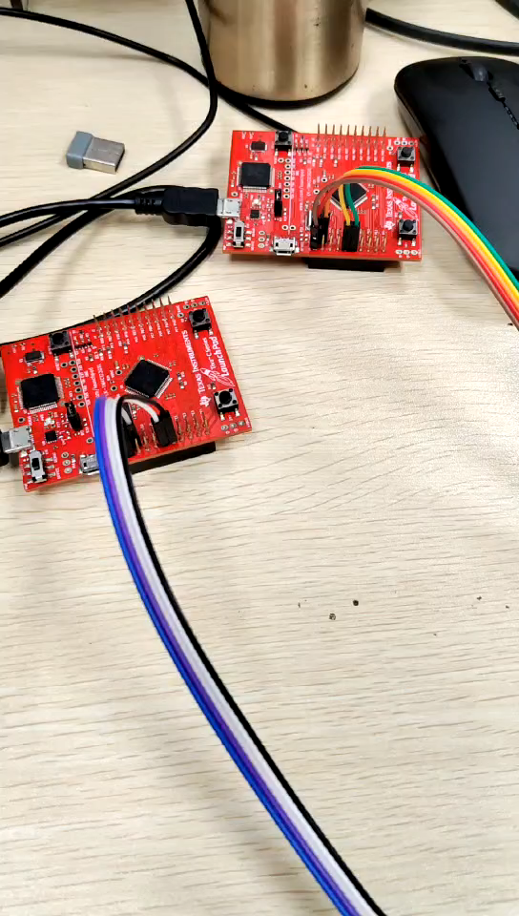
Summary
Expected results:

Slide 71
Q&A
Thanks for listening！ Q & A

